Slide 1
Title – Buying Prediction of Iphone.
By
Pranit Pisal

Slide 2

Objective
To predict whether the customer will buy Iphone or not.

Slide 3

Solution
Doing EDA on current dataset.
Using Decision Tree Classifier over the current data.
Analysing the insights and Graph patterns.
Finding out the right patterns.
Checking the values on which the buying of the Iphone depends upon.
Choosing the efficient AI model.

Slide 4
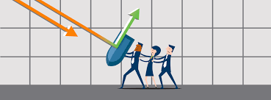
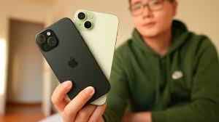
Business Impact
The solution provides help in predicting the customers if they will buy or not and also helps in targeting the customers which meets the requirements.

